Slide 1
Project: AI Powered Automatic Time Table Generator
Medical Store Management System
Project Review
on
“AI Powered Automatic Time Table Generator”
Presented By
1. Pragati Sarjerao Shinde 2167621242039
2. Sanika Abaso Patil 2167621242036
3. Manoj Sanjay Potdar 2167621242018
Guided By
Prof. S. S. Gawade
Dept. of Computer Science & Engg. NMCOE, Peth Guide: Prof. S. S. Gawade

Slide 2
Project: AI Powered Automatic Time Table Generator
Medical Store Management System
Contents
Introduction
Problem Statement
Objective
Technology Used
Result
Conclusion
Dept. of Computer Science & Engg. NMCOE, Peth Guide: Prof. S. S. Gawade

Slide 3
Project: AI Powered Automatic Time Table Generator
Medical Store Management System
Introduction
Managing college timetables can be a complex task, involving numerous variables such as class schedules, faculty availability, and student preferences. To simplify this process, our project, the “Automatic Timetable Generator”, offers a revolutionary solution. By leveraging advanced technology, our project automatically creates efficient and conflict-free schedules, taking into account room availability, instructor timings, and student course selections. This system can quickly adapt to any changes and provides an easy-to-use interface for seamless schedule management.
Dept. of Computer Science & Engg. NMCOE, Peth Guide: Prof. S. S. Gawade

Slide 4
Project: AI Powered Automatic Time Table Generator
Medical Store Management System
Problem Statement
Creating college timetables is often very complicated and time-consuming. Schools have to deal with many factors like class times, teacher availability, and student schedules, which can lead to mistakes and scheduling conflicts.
Our project, the “AI-Powered Automatic Timetable Generator”, aims to solve these problems by using advanced technology to automatically create perfect schedules. This system will make timetable management easier and more accurate, saving time and reducing errors.
Dept. of Computer Science & Engg. NMCOE, Peth Guide: Prof. S. S. Gawade

Slide 5
Project: AI Powered Automatic Time Table Generator
Medical Store Management System
Objectives
Automate Timetable Creation: Use AI to automatically generate timetables based on given parameters (e.g., subjects, teachers, rooms, etc.).
Optimize Resource Utilization: Ensure efficient use of resources like classrooms, teachers, and time slots.
Minimize Conflicts: Prevent scheduling conflicts, such as double-booking teachers or rooms.
User-Friendly Interface: Provide an easy-to-use interface for users to input data and receive the timetable.
Dept. of Computer Science & Engg. NMCOE, Peth Guide: Prof. S. S. Gawade

Slide 6
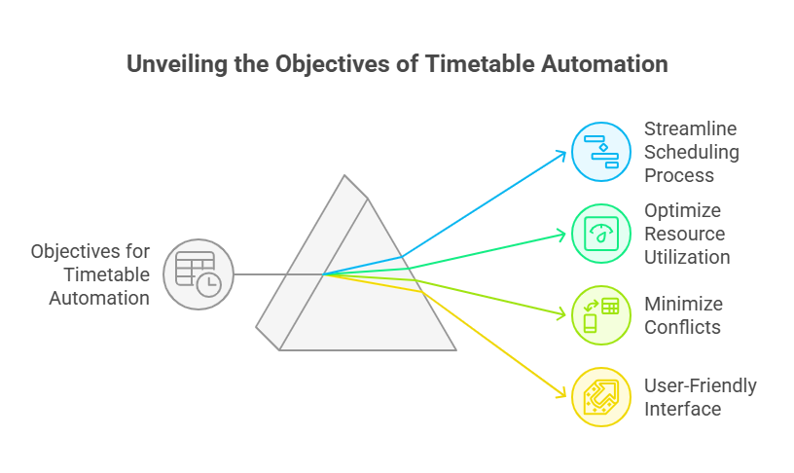
Project: AI Powered Automatic Time Table Generator
Medical Store Management System
Dept. of Computer Science & Engg. NMCOE, Peth Guide: Prof. S. S. Gawade

Slide 7
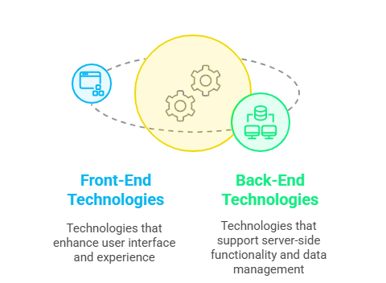
Project: AI Powered Automatic Time Table Generator
Medical Store Management System
Technology Used
Front end
HTML
CSS
Java Script
Bootstrap
React.js
Python functions
Back end
Python
MERN
Dept. of Computer Science & Engg. NMCOE, Peth Guide: Prof. S. S. Gawade

Slide 8
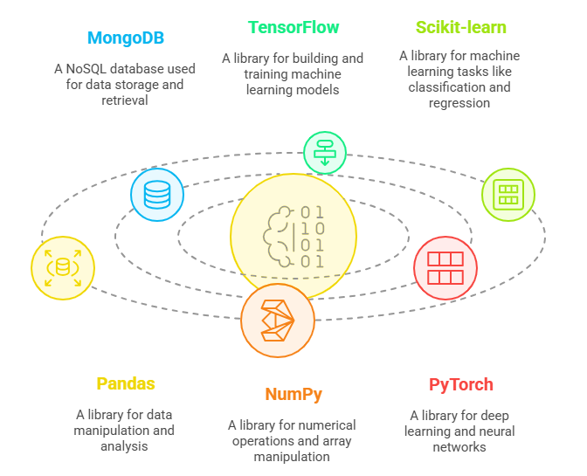
Project: AI Powered Automatic Time Table Generator
Medical Store Management System
Technology Used
Database
MongoDB
AI-ML Libraries
TensorFlow
Scikit-learn
Pandas
NumPy
PyTorch
Dept. of Computer Science & Engg. NMCOE, Peth Guide: Prof. S. S. Gawade

Slide 9
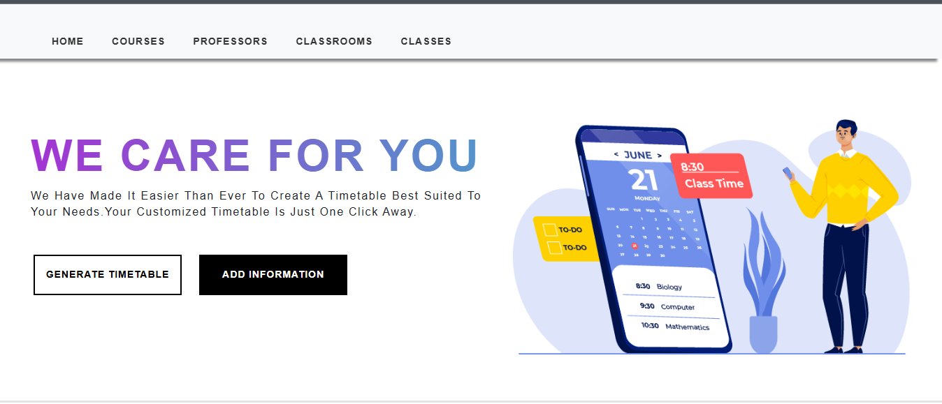
Project: AI Powered Automatic Time Table Generator
Medical Store Management System
Result
Dept. of Computer Science & Engg. NMCOE, Peth Guide: Prof. S. S. Gawade

Slide 10

Project: AI Powered Automatic Time Table Generator
Medical Store Management System
Result
Dept. of Computer Science & Engg. NMCOE, Peth Guide: Prof. S. S. Gawade

Slide 11
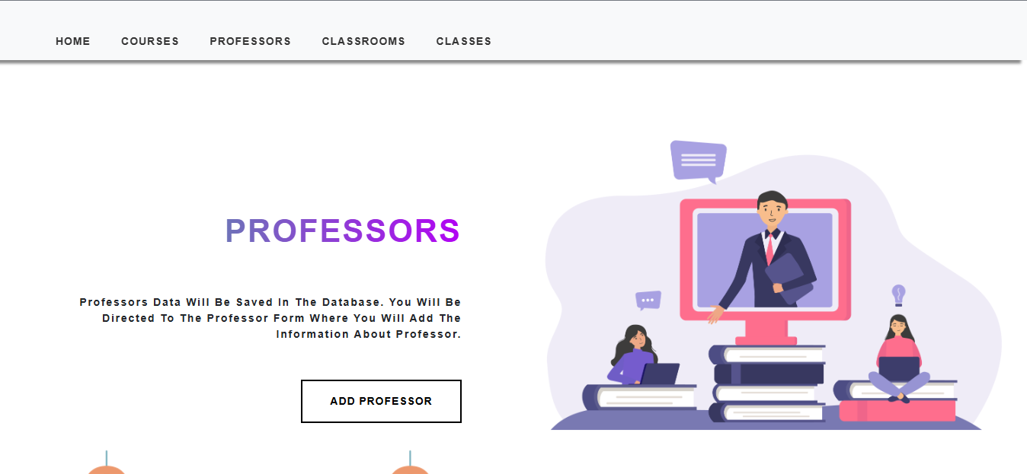
Project: AI Powered Automatic Time Table Generator
Medical Store Management System
Result
Dept. of Computer Science & Engg. NMCOE, Peth Guide: Prof. S. S. Gawade

Slide 12
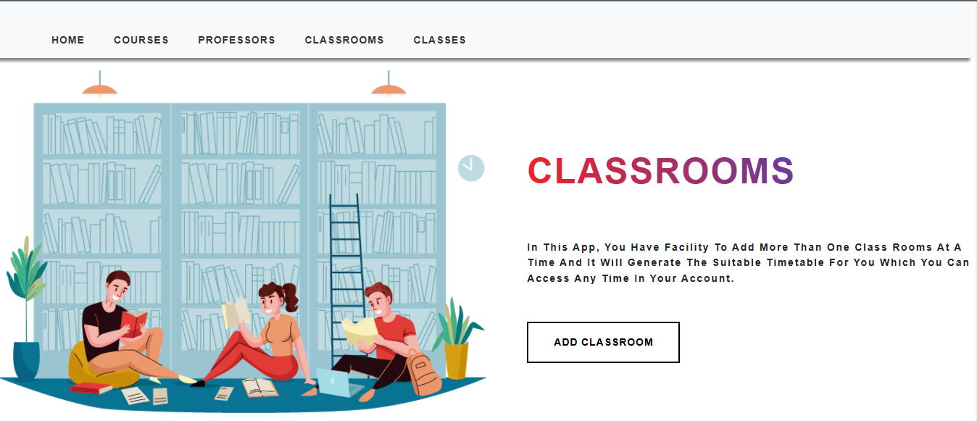
Project: AI Powered Automatic Time Table Generator
Medical Store Management System
Result
Dept. of Computer Science & Engg. NMCOE, Peth Guide: Prof. S. S. Gawade

Slide 13
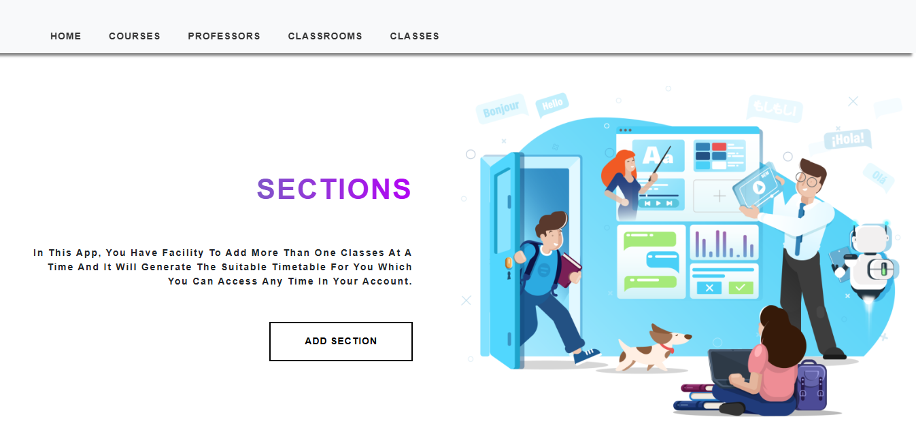
Project: AI Powered Automatic Time Table Generator
Medical Store Management System
Result
Dept. of Computer Science & Engg. NMCOE, Peth Guide: Prof. S. S. Gawade

Slide 14
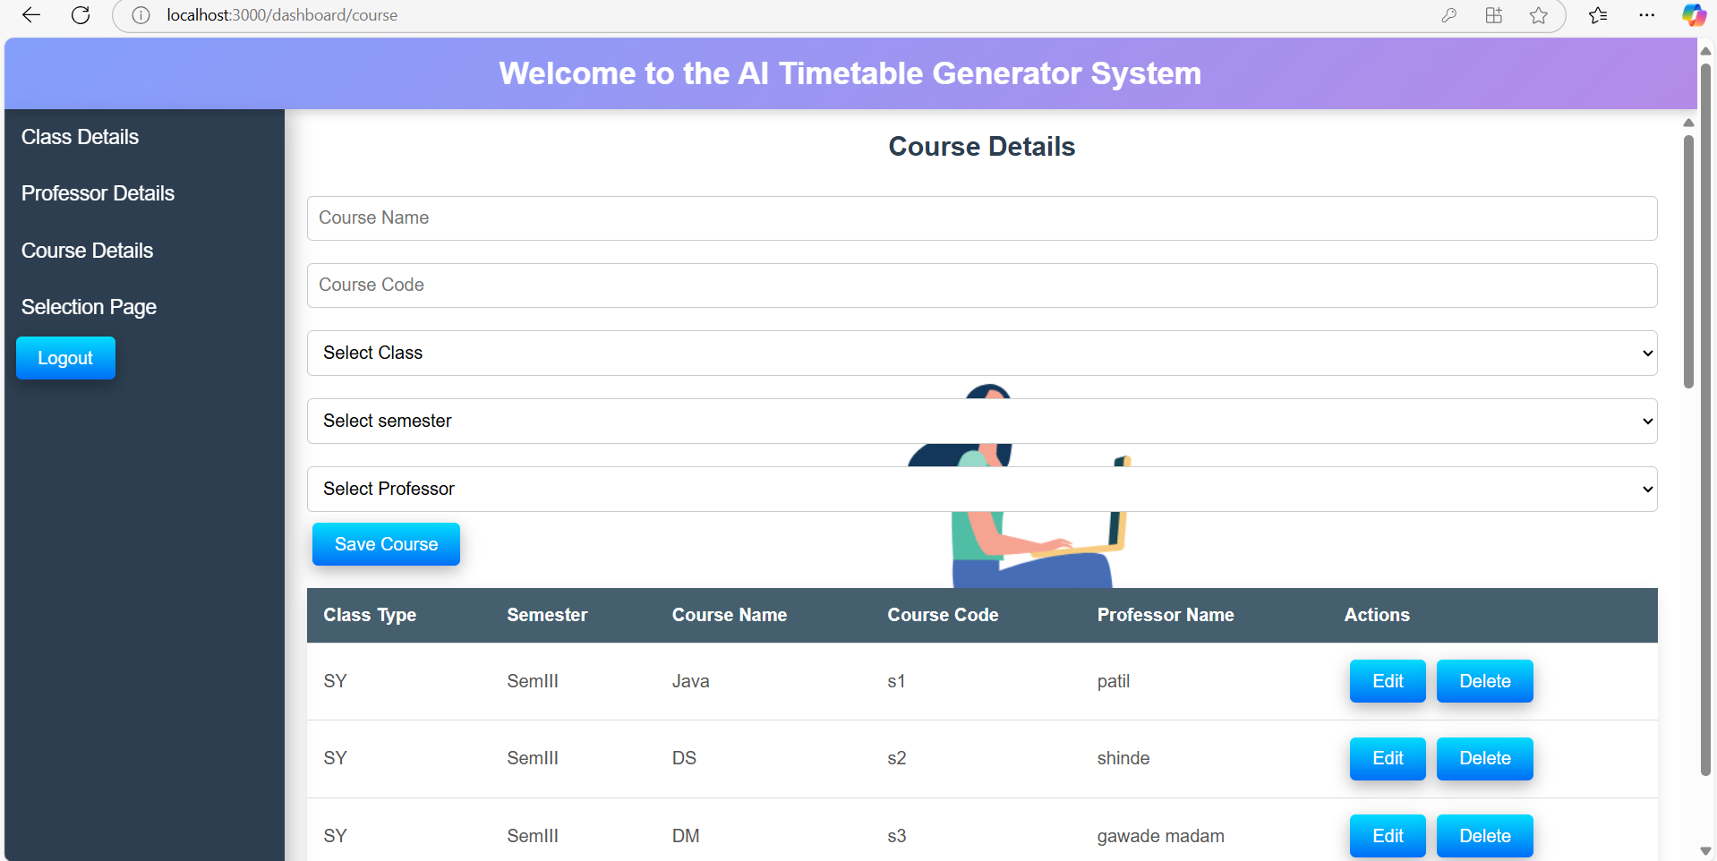
Project: AI Powered Automatic Time Table Generator
Medical Store Management System
Result
Dept. of Computer Science & Engg. NMCOE, Peth Guide: Prof. S. S. Gawade

Slide 15
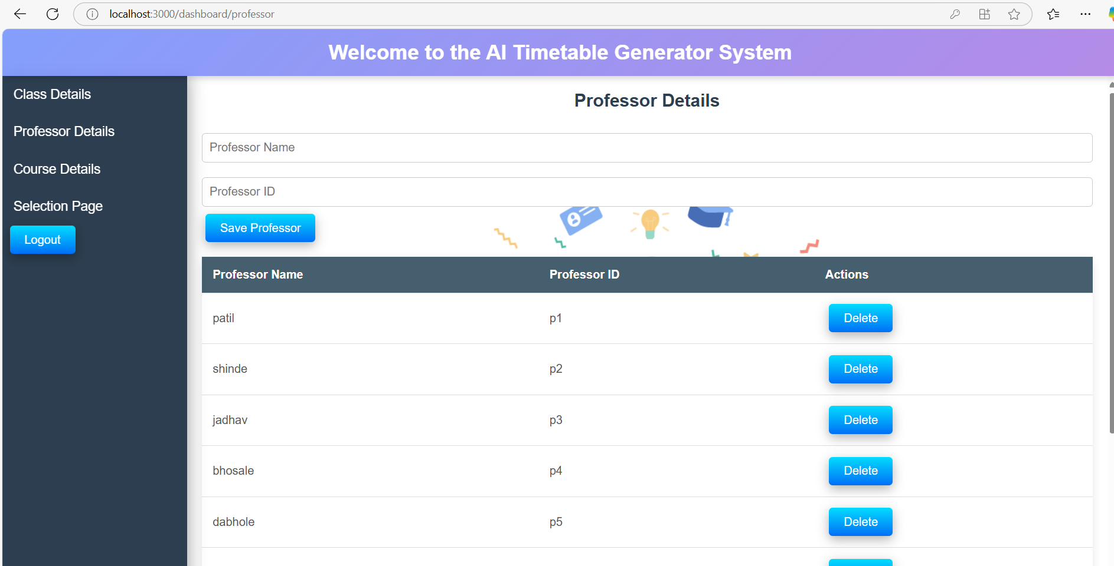
Project: AI Powered Automatic Time Table Generator
Medical Store Management System
Result
Dept. of Computer Science & Engg. NMCOE, Peth Guide: Prof. S. S. Gawade

Slide 16
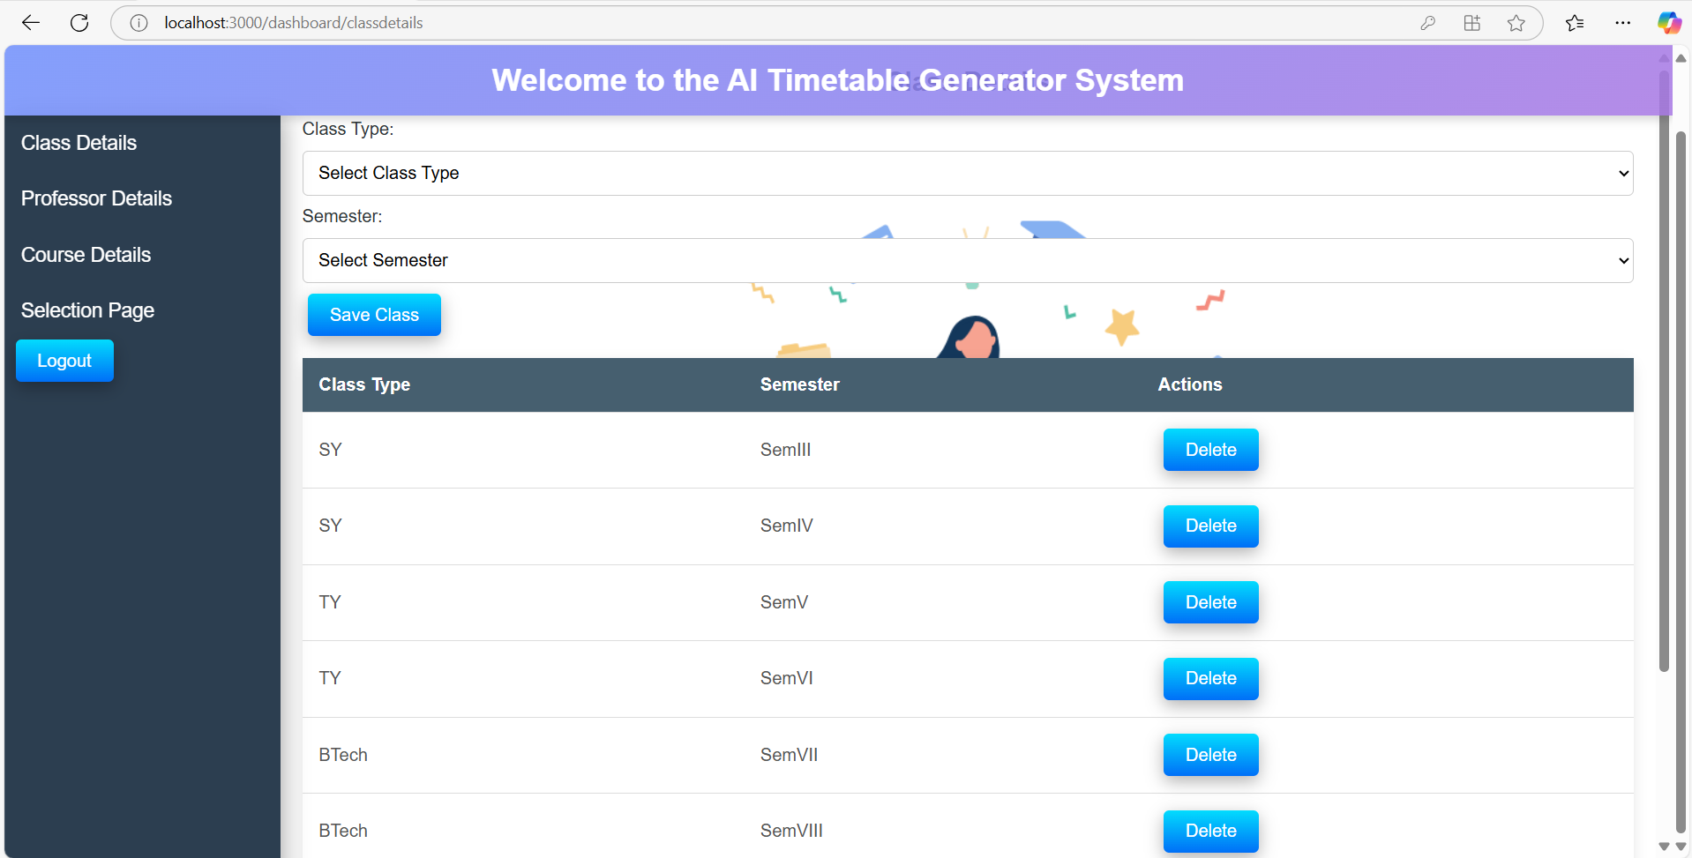
Project: AI Powered Automatic Time Table Generator
Medical Store Management System
Result
Dept. of Computer Science & Engg. NMCOE, Peth Guide: Prof. S. S. Gawade

Slide 17
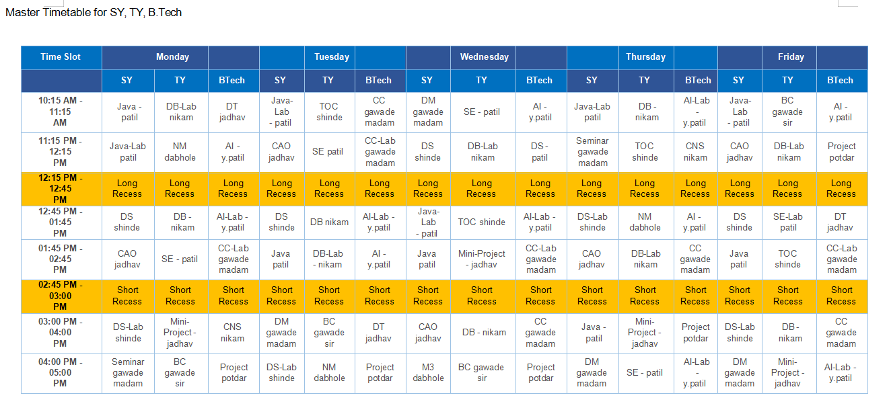
Project: AI Powered Automatic Time Table Generator
Medical Store Management System
Result
Dept. of Computer Science & Engg. NMCOE, Peth Guide: Prof. S. S. Gawade

Slide 18
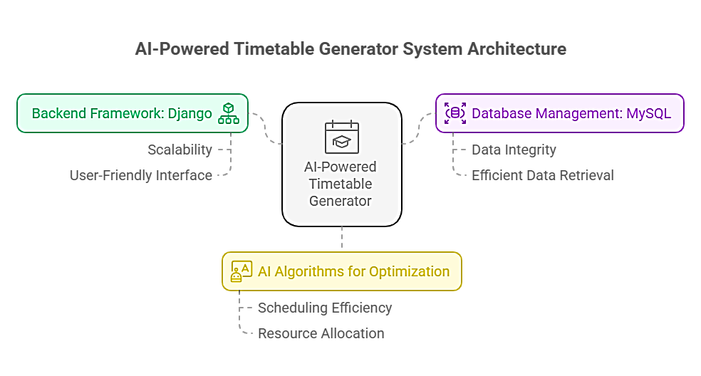
Project: AI Powered Automatic Time Table Generator
Medical Store Management System
Conclusion
The AI-Powered Timetable Generator is a robust, automated solution to the complex problem of scheduling academic timetables. By integrating Django for the backend, MySQL for the database, and AI algorithms for optimization, this project offers a scalable and user-friendly platform to streamline the process of timetable creation.
Dept. of Computer Science & Engg. NMCOE, Peth Guide: Prof. S. S. Gawade

Slide 19
Project: AI Powered Automatic Time Table Generator
Thank You
Dept. of Computer Science & Engg. NMCOE, Peth Guide: Prof. S. S. Gawade

